Slide 1
Travelling Thief Problem
Brought to you by PlanB

Slide 2
Members
Gaskó Noémi - Mentor
Györi Robert - Server
Józsa Ákos - Algorithm
Kui Norbert - Algorithm
Török Zoltán - Algorithm
Szász Imre - Google Maps API / WebUI
Szász Szilárd - Google Maps API / WebUI

Slide 3



Scope of the Project
The Process
We set out to implement the combination of two known problems:
Traveling Salesman Problem (TSP)
Knapsack Problem (KP)
Mark points on Map
Calculate route between points
Server calculates best route
Optimal route is marked on map

Slide 4
Please tell me more…
Traveling Salesman Problem?
Knapsack Problem?
You have n cities;
The distances between them;
Visit all;
Taking the shortest path;
And get back home
You have a knapsack;
It has limited space;
There are items;
Items have value and weight;
Gather as much value as you can

Slide 5
So, what did you do?
But how does it work?
Traveling Thief Problem (TTP)?
A combination of the previous two:
Either you know the items and plan the shortest route to gather the best;
Or you visit every city and optimize your value/weight ratio

Slide 6
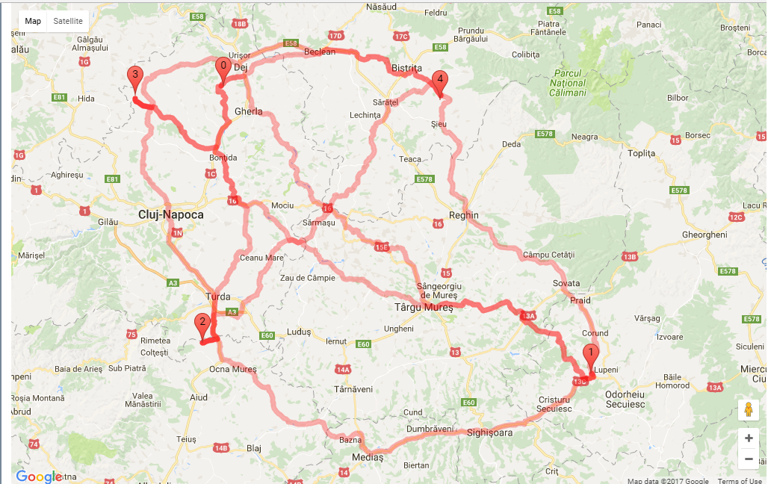
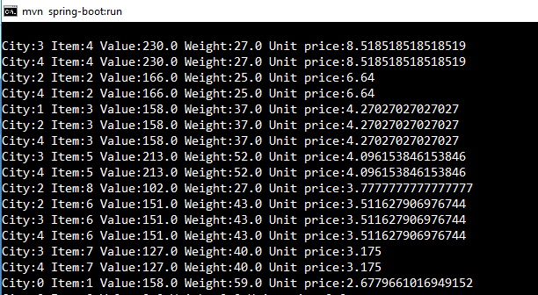
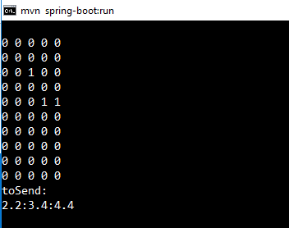
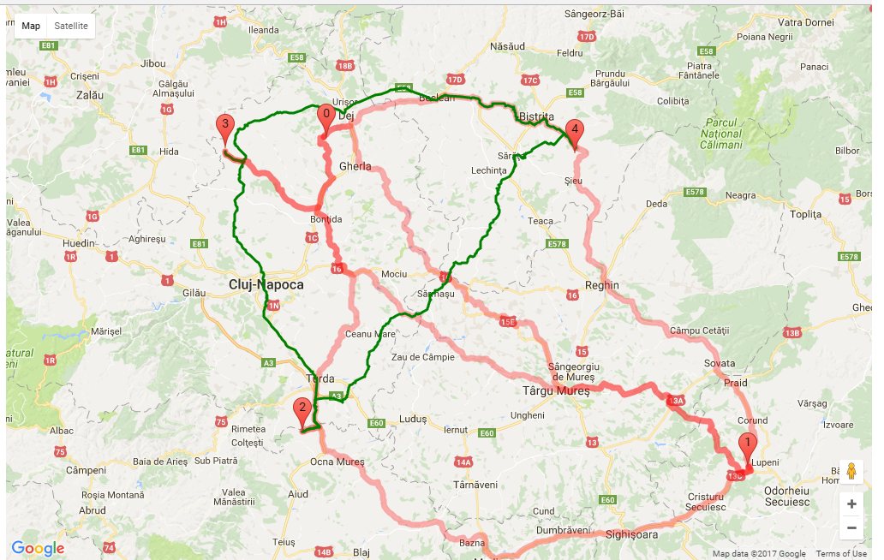

Slide 7
Technologies
Spring
Java
HTML / CSS / Javascript
jQuery
Google Maps
Github

Slide 8

Difficulties
Google Maps API accepts limited number of requests
Solution: Add sleep() calls when the number of requests becomes large
The skeleton project and functions were in Matlab, using built in functions
Solution: Write everything from the ground up
Scheduling meeting for the group
Solution: Schedule meeting for the group

Slide 9
Further development
Database to store routes (History)
Optimization of the algorithm
WebUI / GUI improvements for readability
Payed Google Maps API for unlimited requests

Slide 10
Crème de la crème
And now; what everyone came for:

